Slide 1

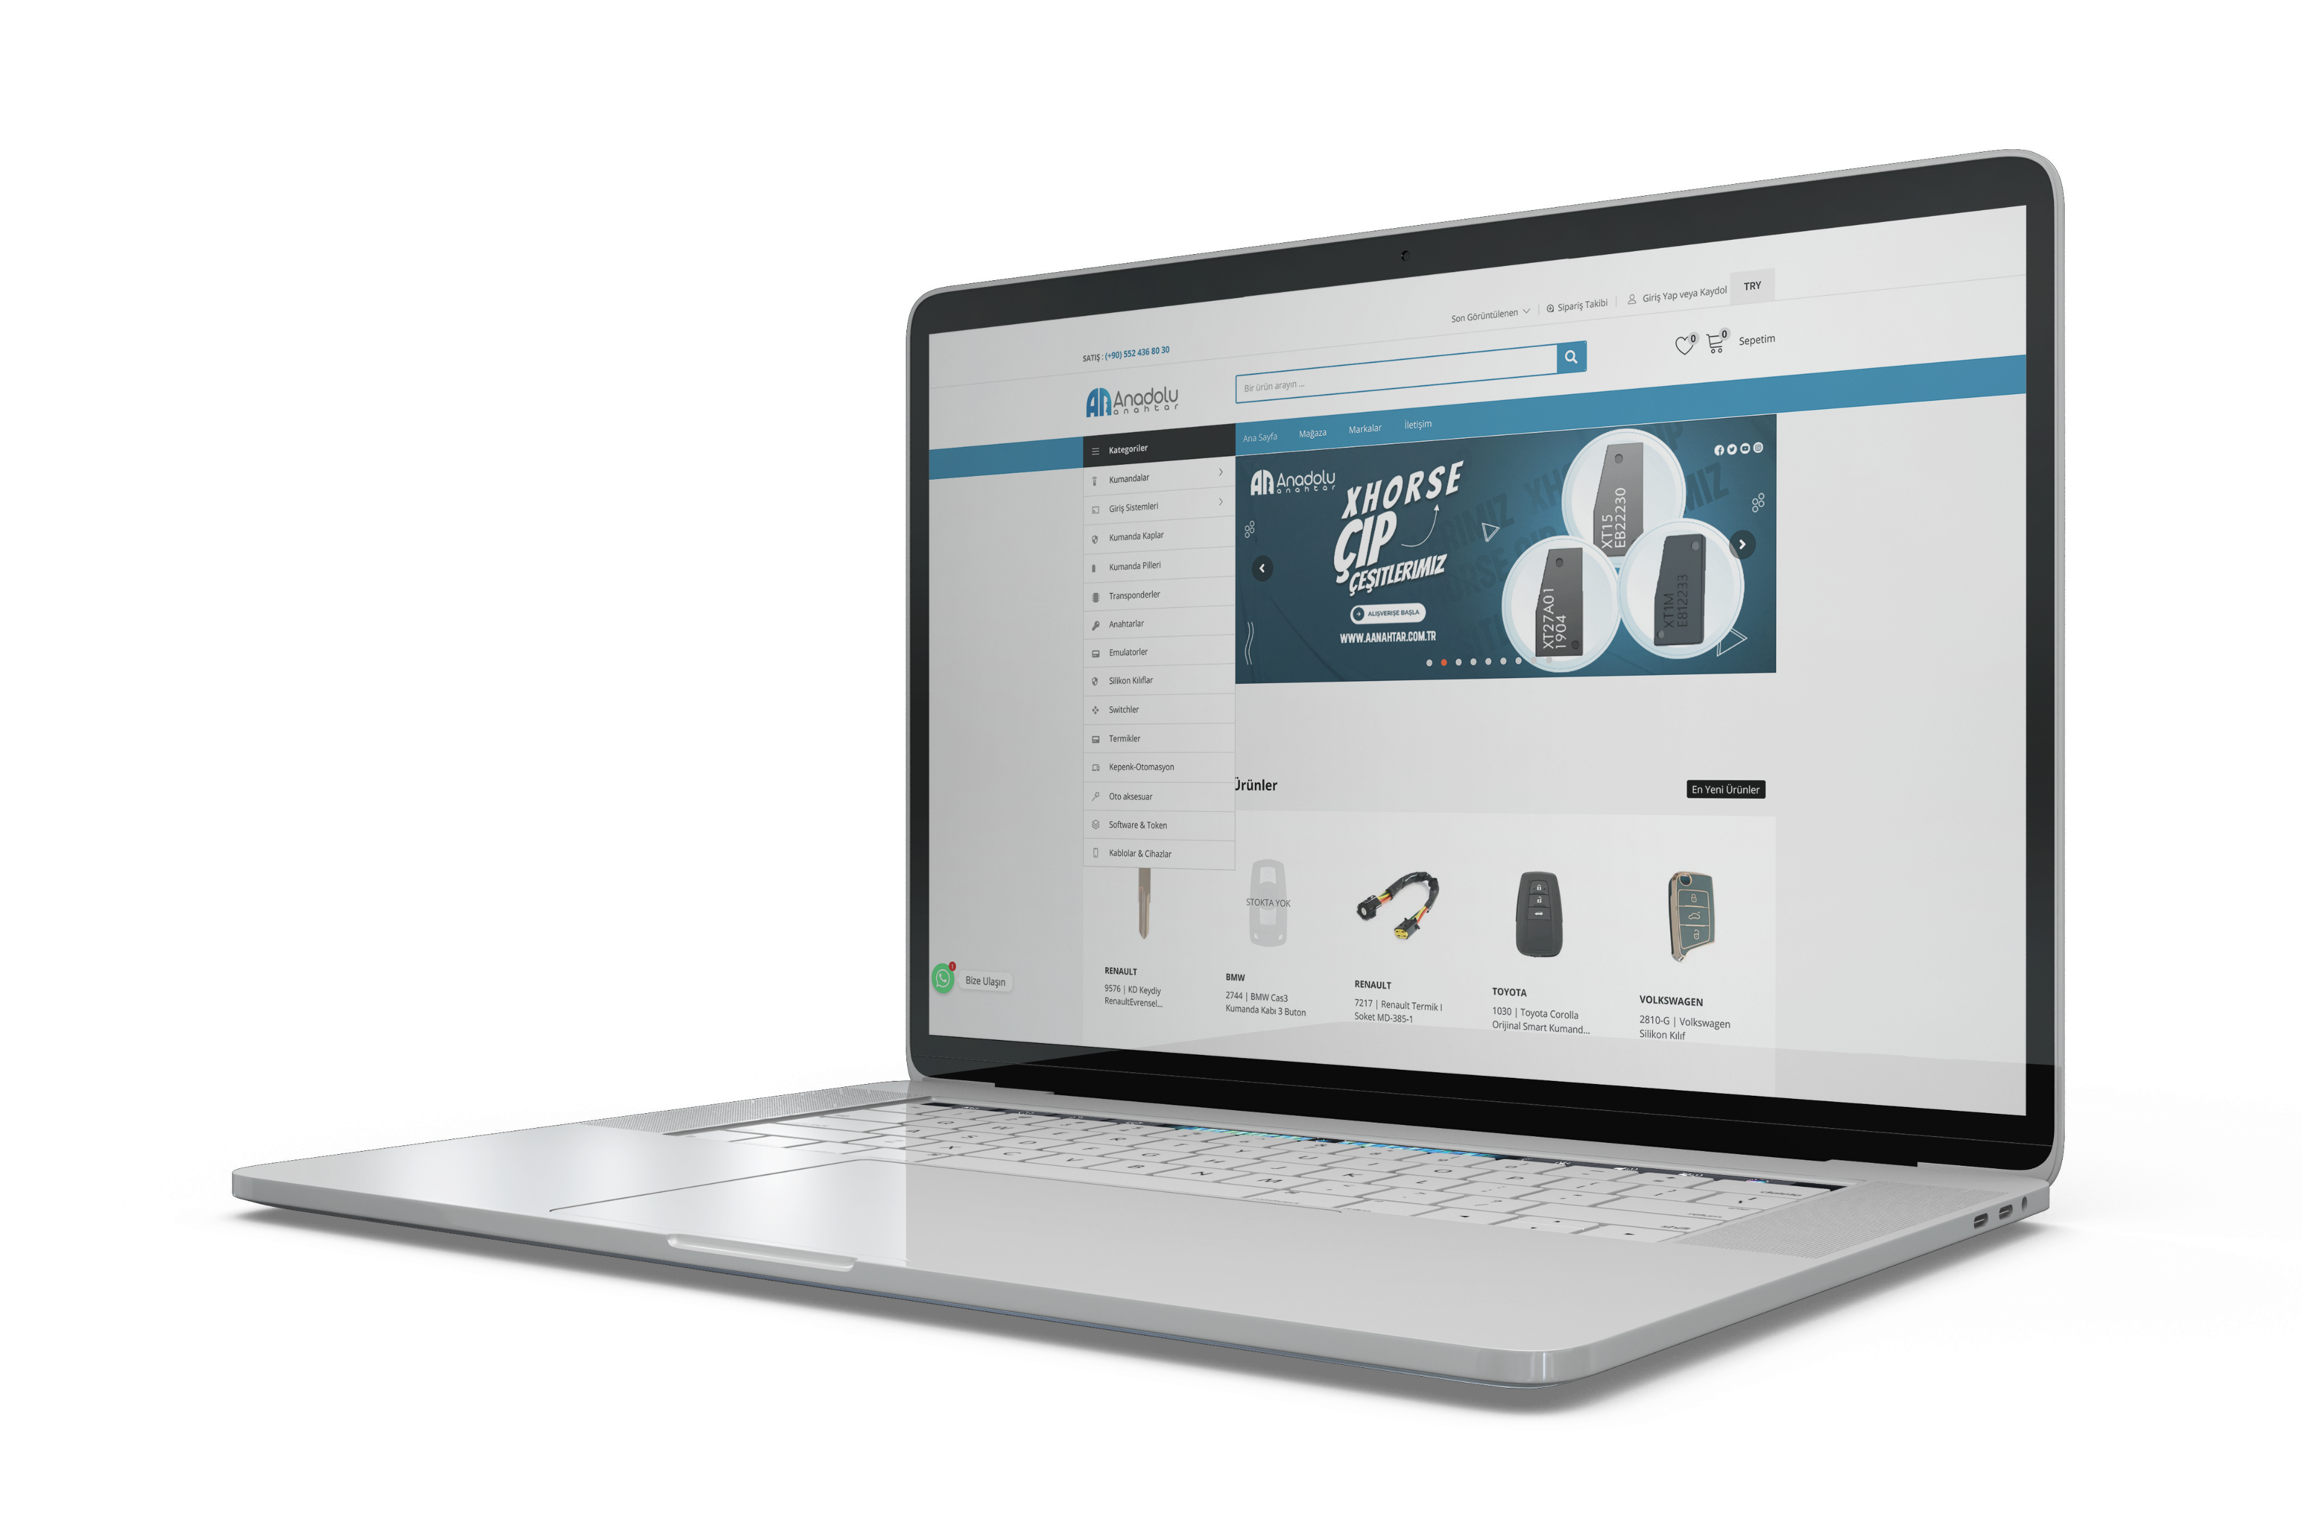

Oto Anahtar ithalat ve toptan ticaret
WWW.AANAHTAR.COM.TR

Slide 2


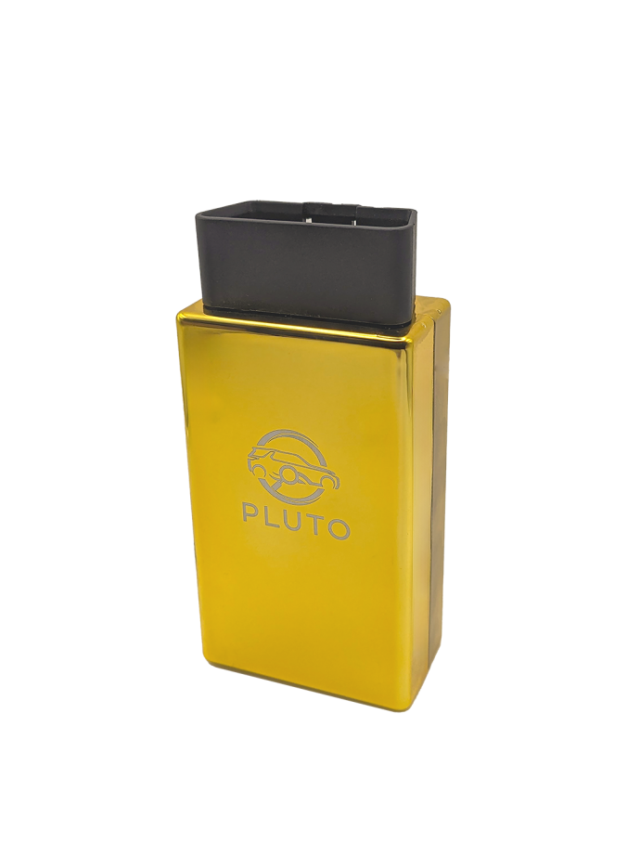
PLUTO JLR
PLUTO JLR Full Package For Land Rover and Jaguar 2017-2024
Spare Key Training

Slide 3
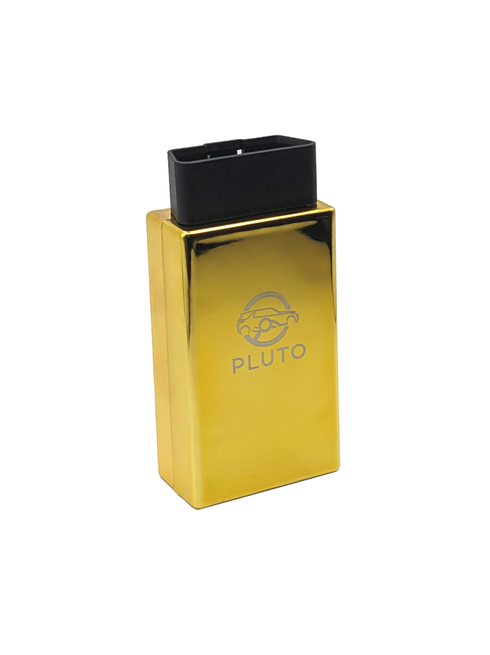


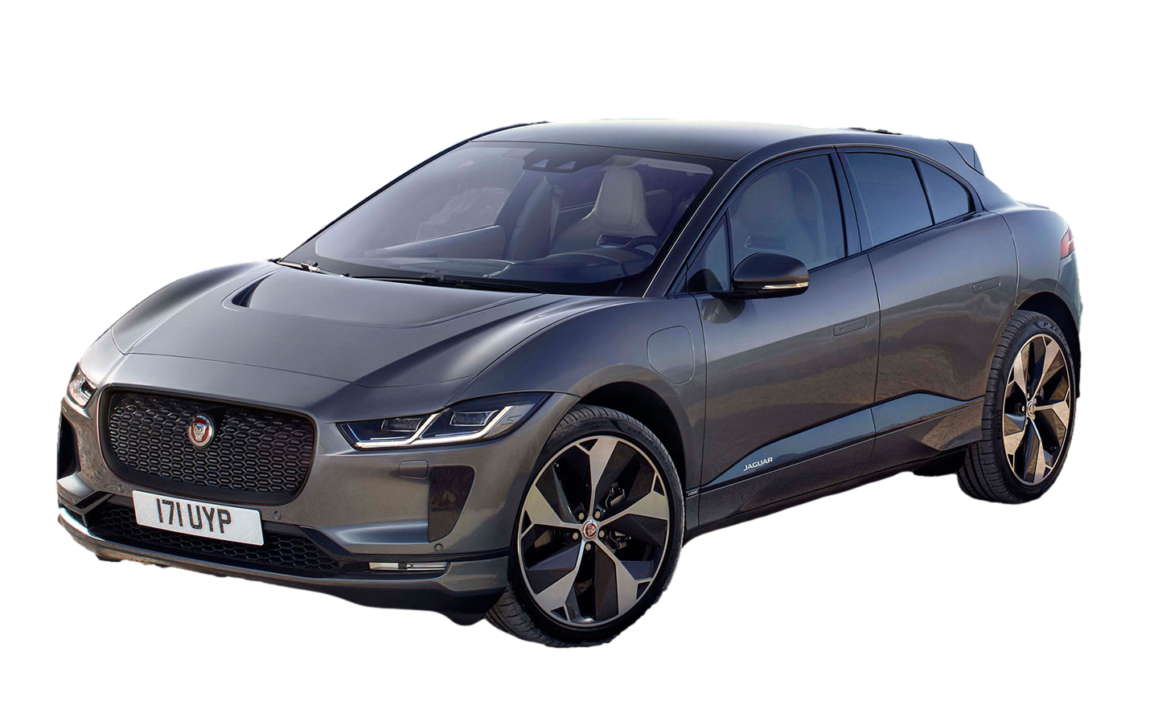
What Is PLUTO JLR?
Notes:
Pluto JLR Full Package for Land Rover and Jaguar Vehicles between 2017-2023. This is a server controlled, token free engineering tool with the following features:
- Coding of all modules - Online flashing, individual flashing and ECU update - each module can be flashed alone, with the choice to manually update to the required software version - Vehicle service reset - Read and erase DTC - Read vehicle info (typology) - Key learning in 1 minute (unique to Pluto) - immobiliser & ECU reset - Replace KVM & BCM - CCF change and VIN writing

Slide 4
Services PLUTO JLR Can Provide
sdg
Advanced
Diagnostics
Module
Programming
Retrofit
Coding
Lost/Spare Key
Programming
Second-Hand
Parts Coding
Notes:
Advanced Diagnostics – a greater understanding and using UDS protocol (unified diagnostic services)
Programming individual modules
Retro fit other compatible units, example, the new defender comes with a small multimedia screen, this looks out of place, a lager compatible can be coded in
Spare keys in 7 mins, in 1 min in some cases
Lost keys, very easy to complete even with BCM replacement
Using second had parts can in some case be coded in,

Slide 5
Who Is PLUTO JLR For?
Auto
Locksmiths
Advanced
Diagnostic Technician
Body
Shops
Garages
Notes:
Auto locksmiths – increasing the vehicles you can program – Say yes when others can't do, including the dealerships - case study – current issues with security stopping dealership and other tools adding a key, PLUTO gives this options to complete, commands the better pricing on jobs – Spare keys £750+ Lost keys £1600+
Diagnostic expert – especially those that fully understand UDS protocol and codes, - Multimedia system not working – vehicle at dealership and many other garages (experts) over a 5-month period – Pluto fixed in 1 hour – client charged and was eager to pay £2000 for this service, client very much doubted it could be completed. – identified the issue using experience of UDS – understood the codes at point of failing, commands inputted to complete the task.
Body shops, dealing with stolen and recovery, a huge amount of stolen JLR will have had the telematics remover, this can cause issues with even moving the vehicle, PLUTO can turn of the telematics so key programming can happen, also deal with crash data to get vehicles moving.
Garages, increase ability to deliver more services for prestige vehicles

Slide 6
Why Choose PLUTO JLR?
Key Programming in 7 mins
Advanced Coding and Programming
Complete Jobs Others Fails On
UK Support
Network
Regular
Updates
Saves
Time
Notes:
Key programming
Advanced coding and programming
Complete jobs others fail on
Be part of the 3D UK support network – standardised training for the auto locksmiths, with master class delivery, also further master classes in the pipeline on more complex work
The tool has regular updates and what couldn't be completed yesterday, may be able to complete today, several cases seen when this has happened, client back on board
Save client time, better service, increase reputationally locally and nationally for services others fail on
Allows you to say yes where others fail

Slide 7
Jaguar iPace
2020/21
Doip
Add a key
2 keys
in total
Demonstration
Notes:
Let's look at the set up and the minimum requirements
DOIP = Diagnostics Over Internet Protocol

Slide 8
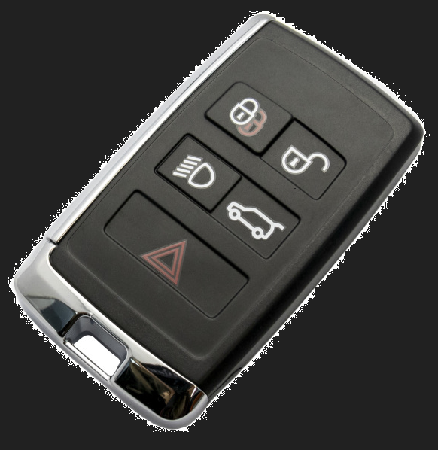
Demonstration The set up
PLUTO
Security USB
KVM – Part check
Keys – PEPs or NON PEPs (passive entry start)
Solid internet reception
Battery support
Notes:
Let's look at the set up and the minim requirements
PLUTO unit
Security USB
Part checked KVM
2 x KEYS (PEPS – NON PEPS)
Solid internet reception
Battery support

Slide 9
Demonstration Check to see if the KVM is locked to add key
Notes:
Let's look at the set up and the minim requirements
PLUTO unit
Security USB
Part checked KVM
2 x KEYS (PEPS – NON PEPS)
Solid internet reception
Battery support

Slide 10

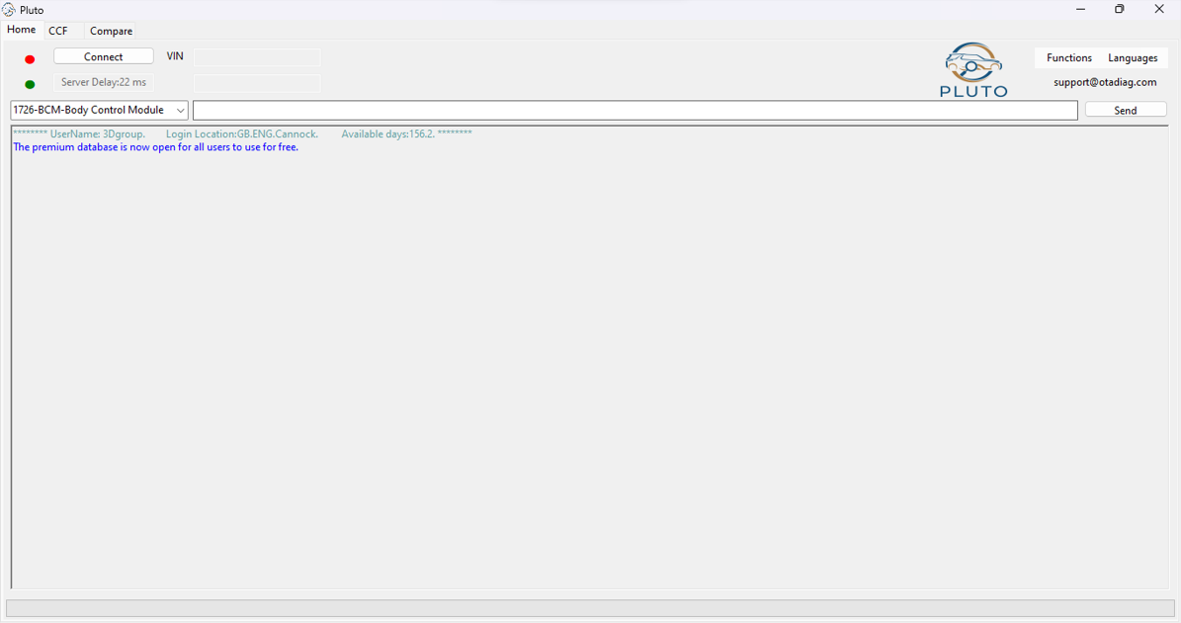
Notes:
Interface – Sometimes in Chinese – Top right box to change language
Connect top left

Slide 11
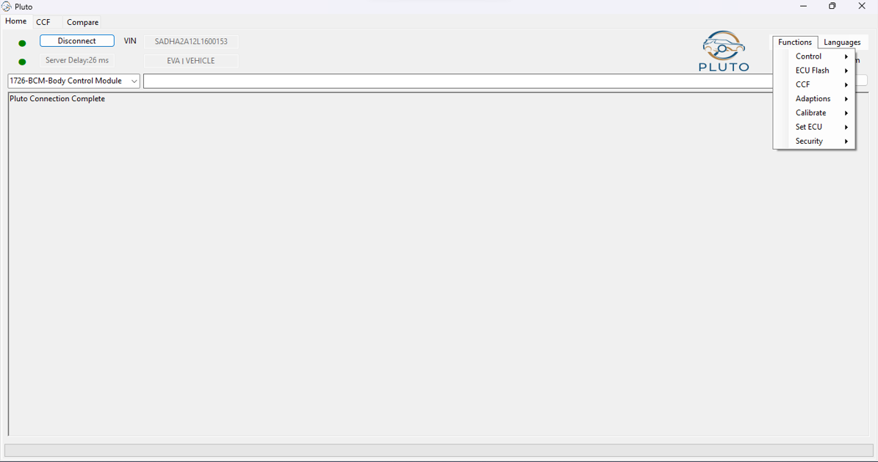
Notes:
Functions
Control

Slide 12
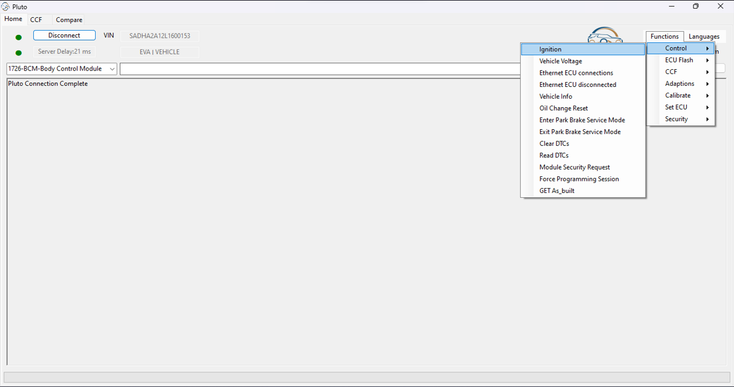
Notes:
Ignition
System will then start to be woken up and ignition will come on

Slide 13
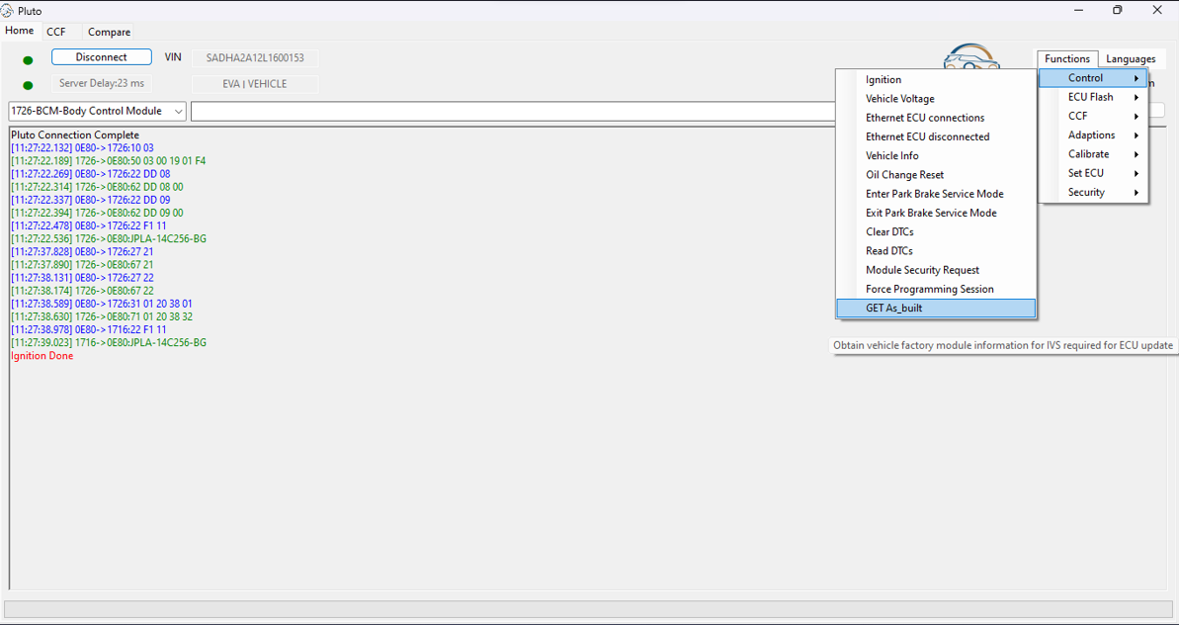
Notes:
You'll see lines of data – this is the UDS I mentioned at the start – Lines of commands and responses
Ignition will then come on
From here we must get the GET AS BUILT information for this vehicle – this is our back up if we run into issues

Slide 14
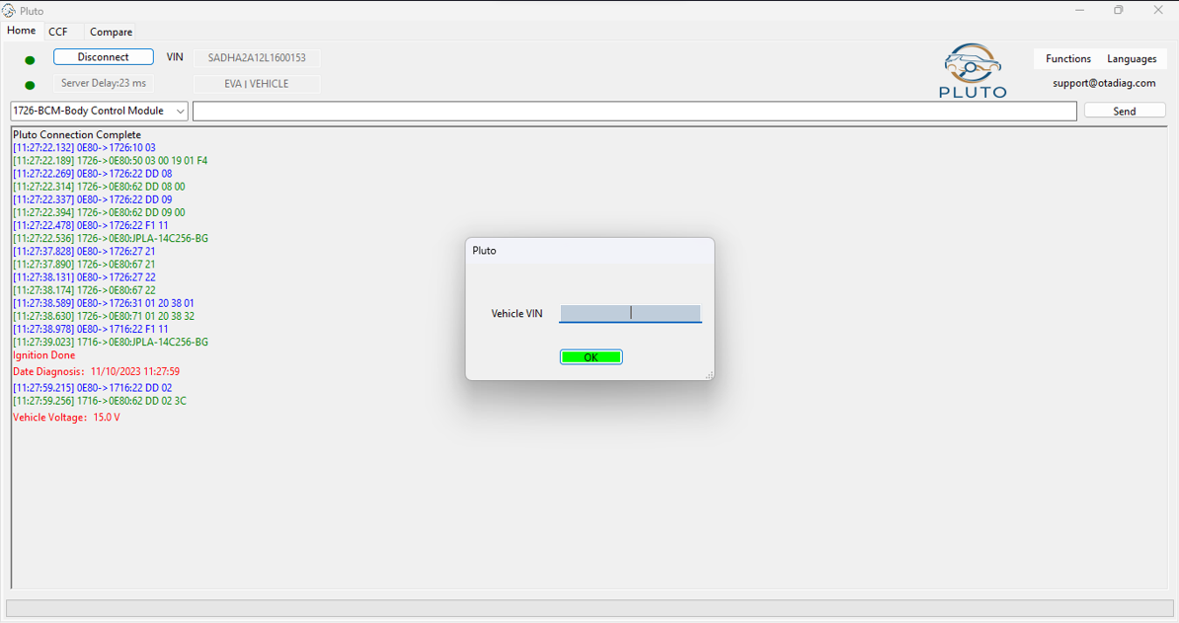
Notes:
Fill in the VIN then copy it incase you require it later
Points to not – Battery support now is very important

Slide 15

Notes:
Vin populated - Press ok

Slide 16
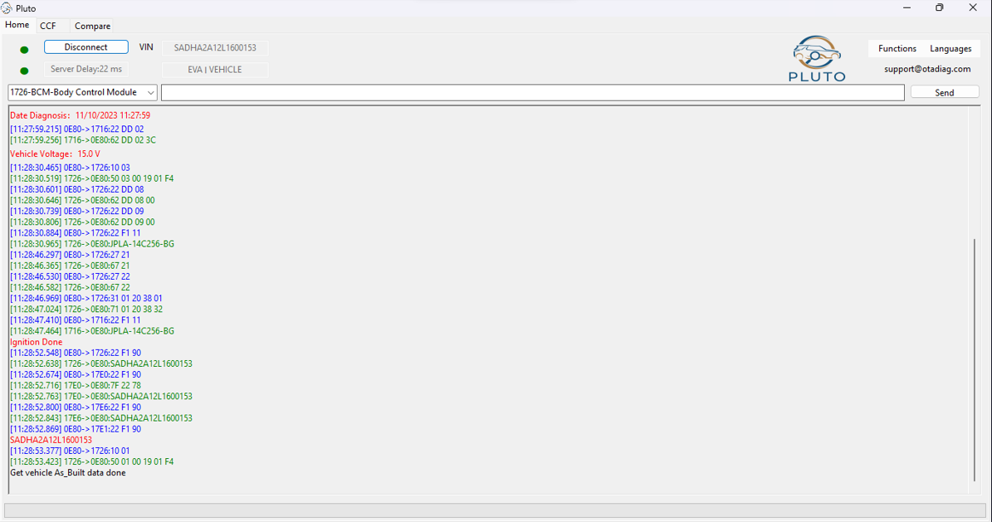
Notes:
Get as built done, this data is saved incase we require to go back to a start point.
More UDS visual, all positive codes – those that have a deeper understanding of UDS and the language, will understand the numbers and commands

Slide 17
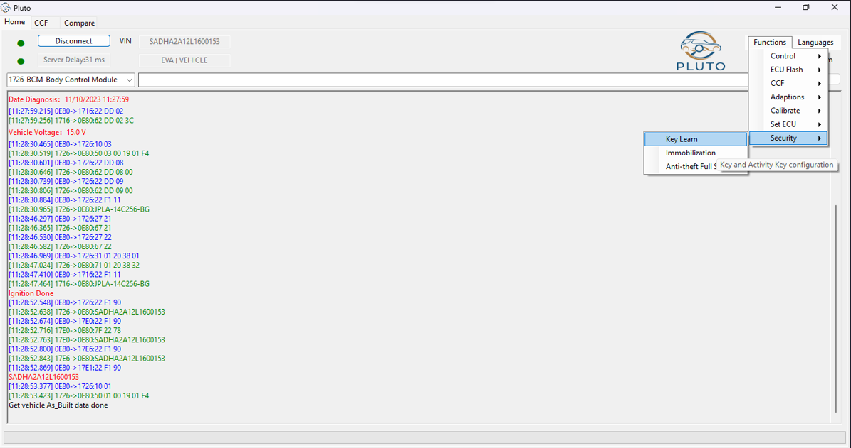
Notes:
Now were ready to add keys
Functions
Security
Key learning

Slide 18
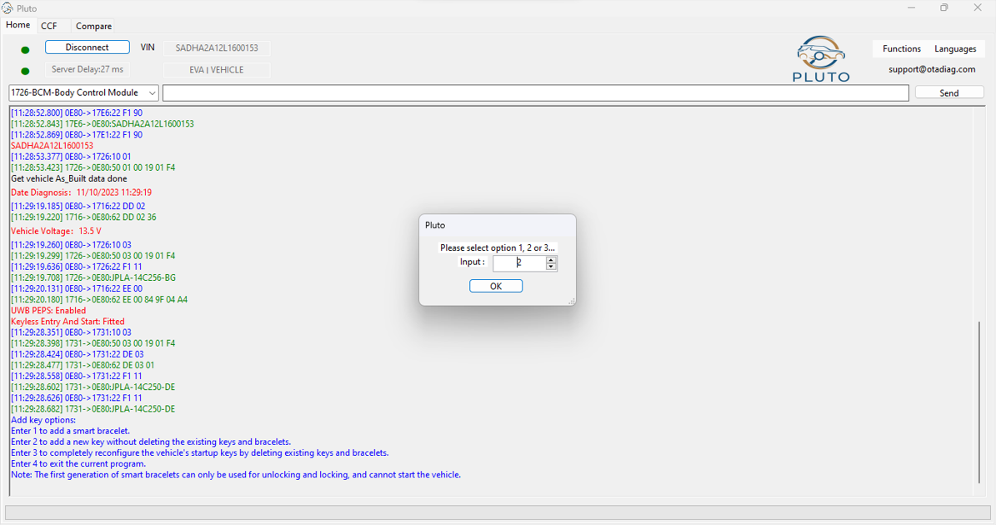
Notes:
Add key option, “Enter 2 to add key without deleting
Press ok

Slide 19
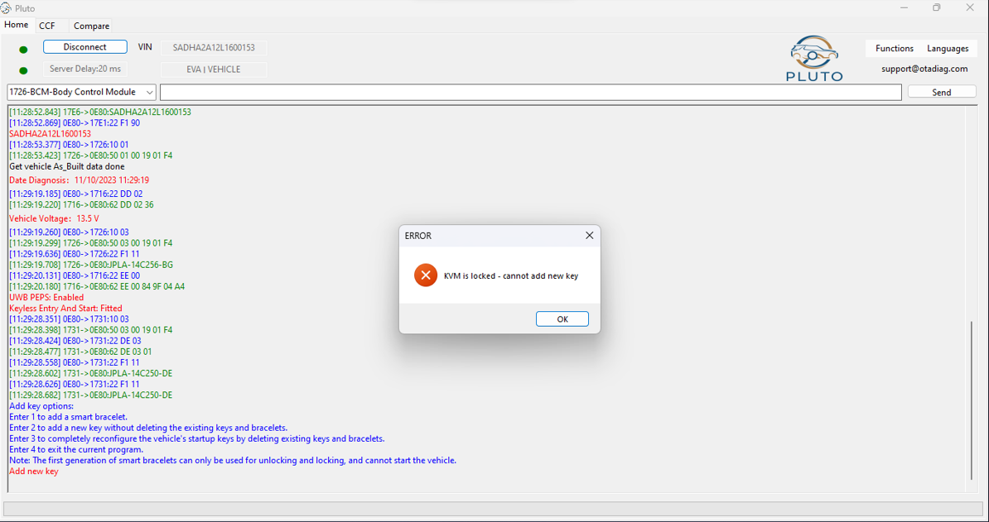
Notes:
This KVM is locked so KVM requires replacing with a new one

Slide 20
Demonstration KVM requires replacing
Notes:
KVM is locked so we require to replace the KVM

Slide 21
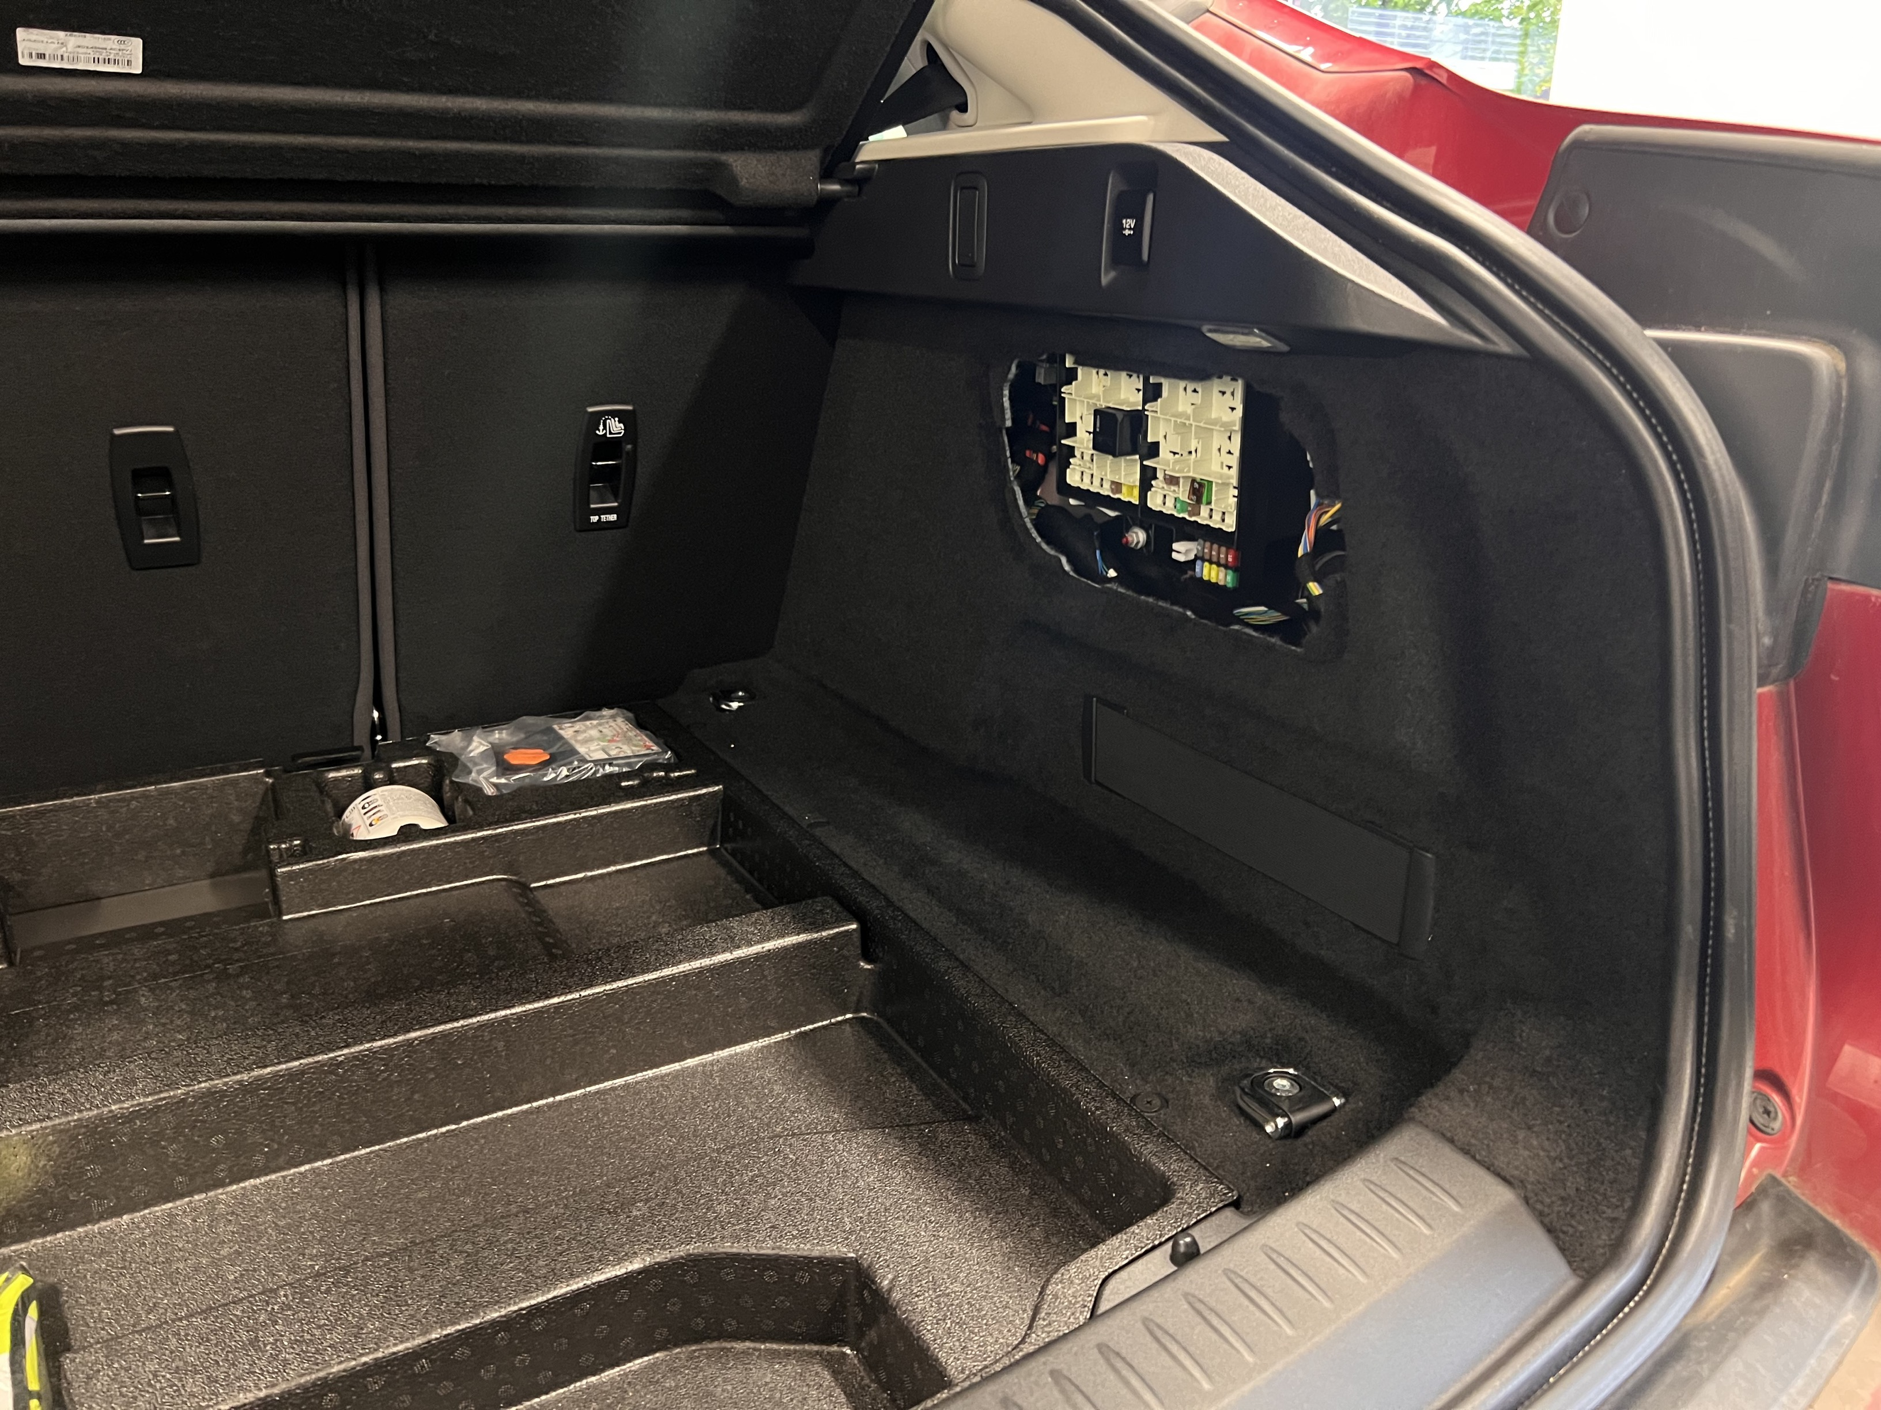
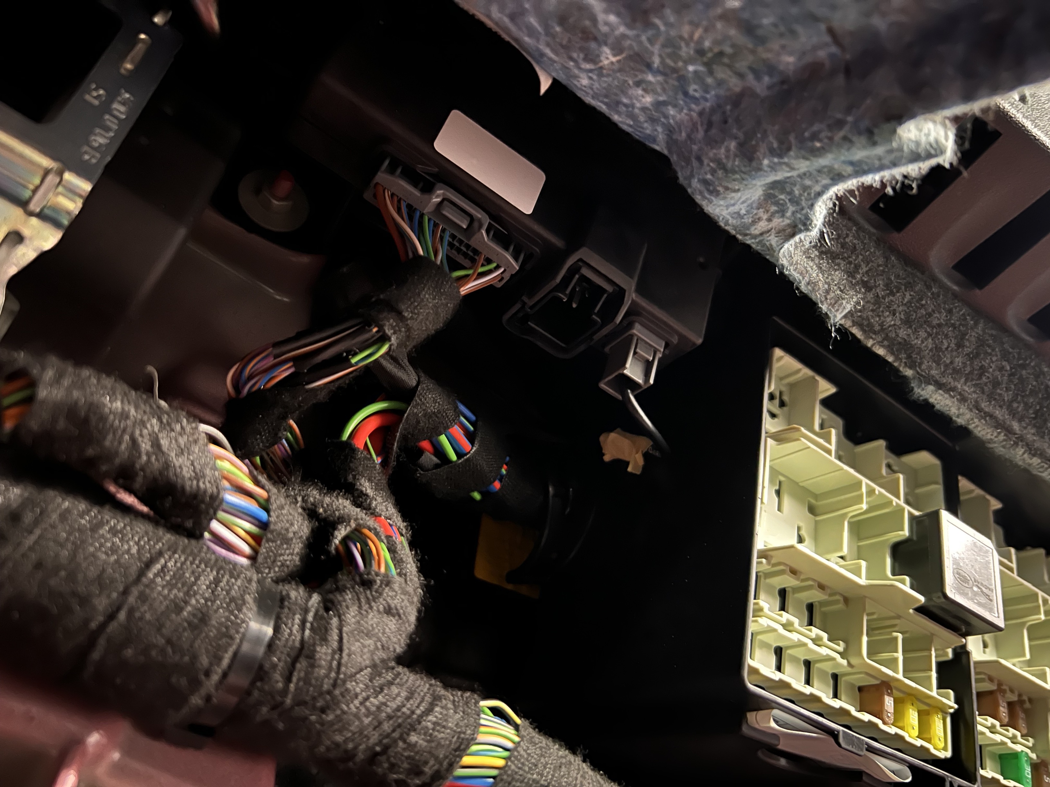
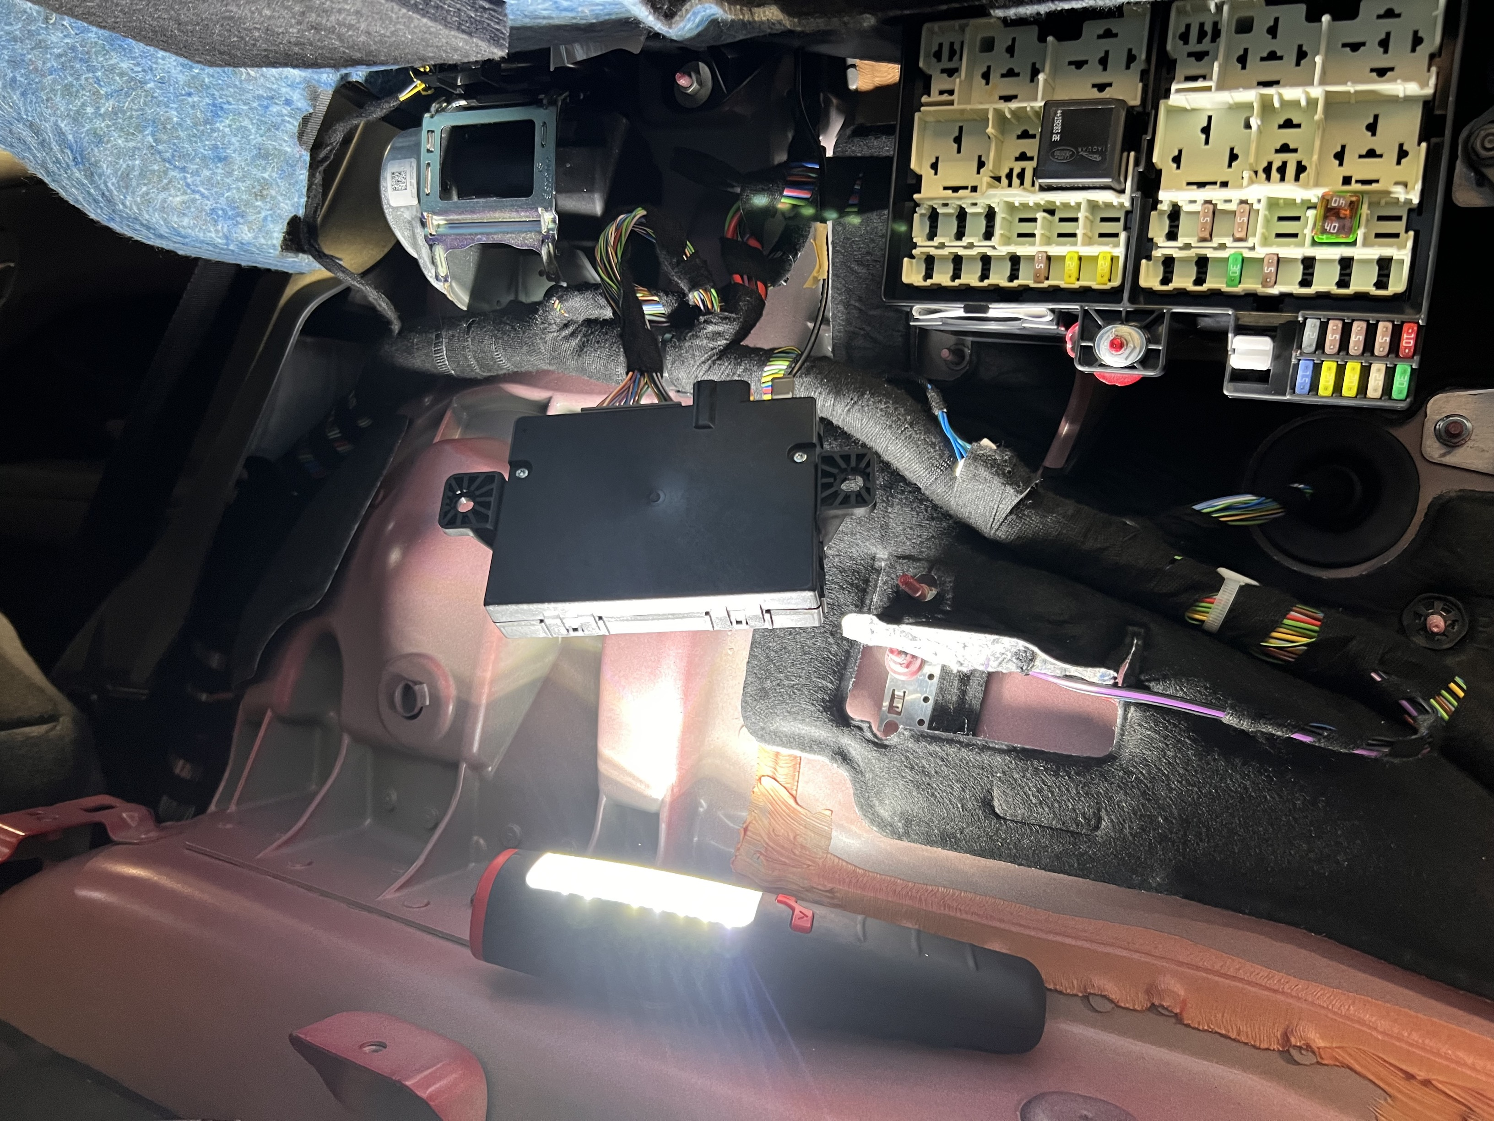
Demonstration KVM requires replacing
Notes:
Describe location
Different for various vehicles

Slide 22
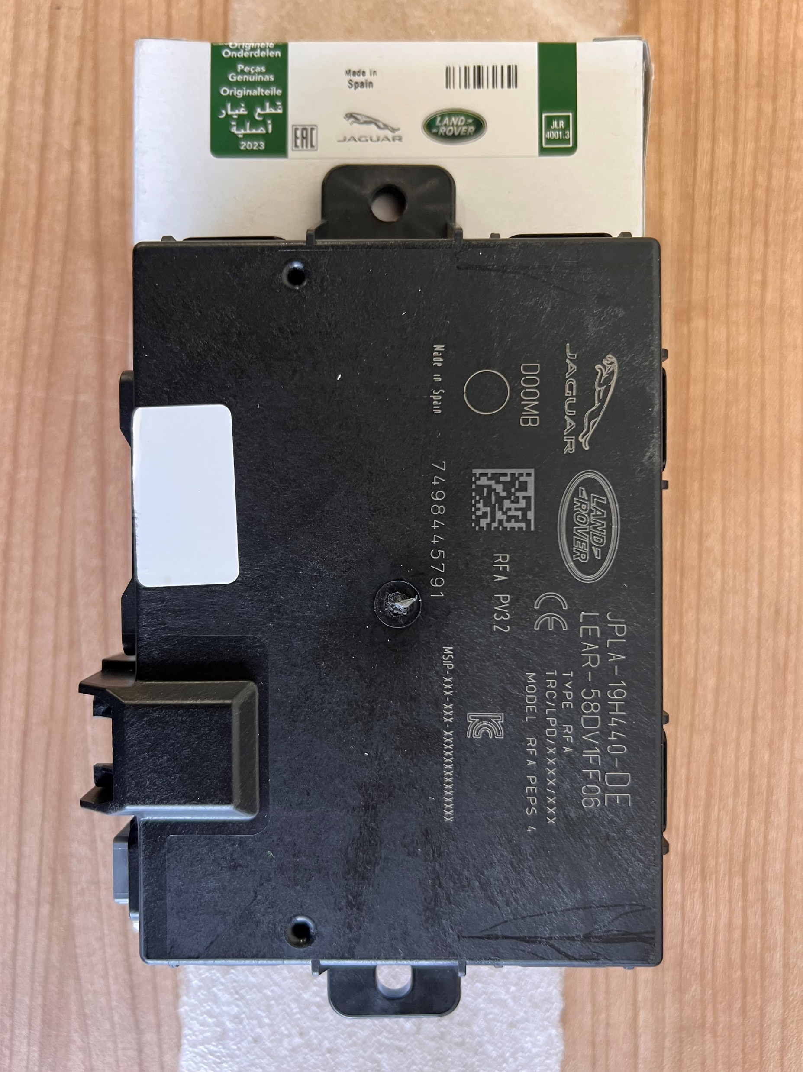
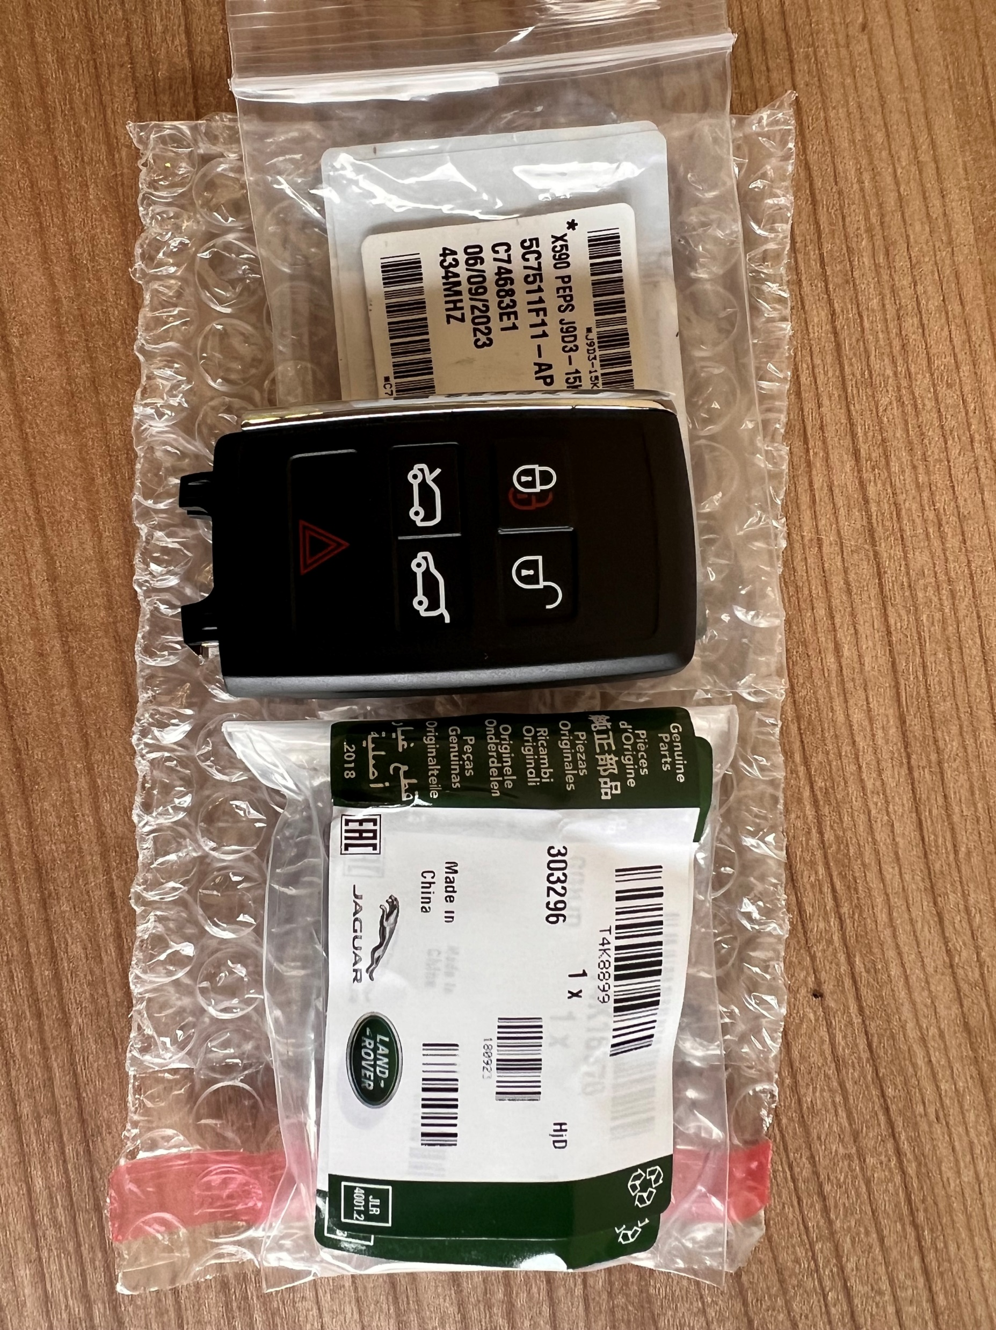
Demonstration KVM requires replacing
Notes:
KVM replacement – Top tip – Part
Compare units - the last 2 letters will be different

Slide 23
Demonstration Next steps
Notes:
KVM is locked so we require to replace the KVM

Slide 24
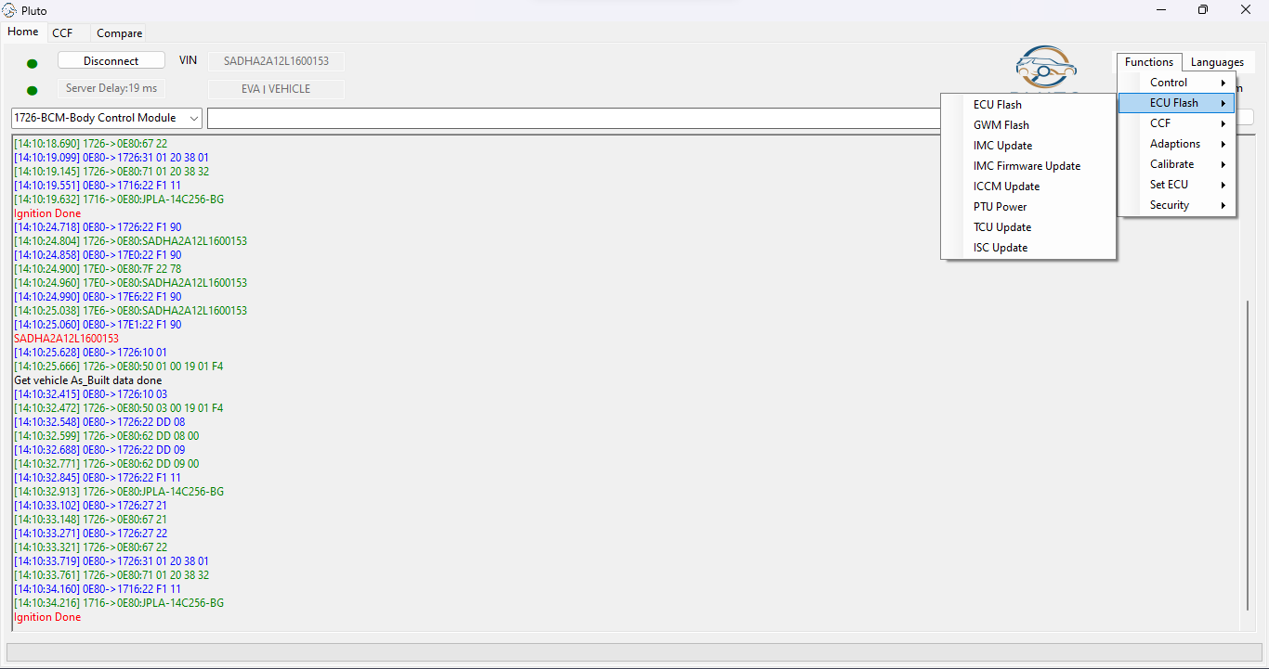
Notes:
Ensure ignition is OFF
Swap KVM for new
Select Functions
ECU Flash
ECU Flash

Slide 25
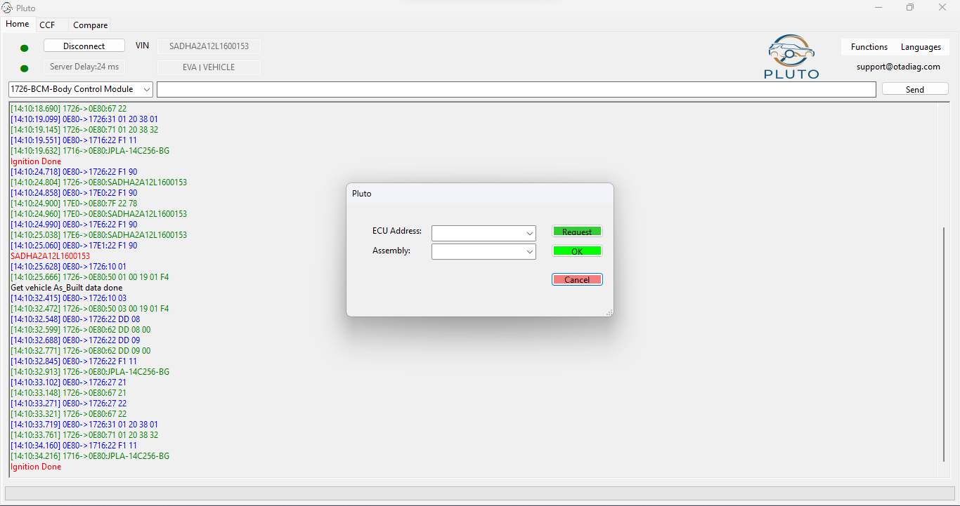
Notes:
ECU for KVM is 1731 – Type in and hit request
Ensure the LATEST update is selected, PLUTO will always select the latest , please double check
Once checked select OK

Slide 26
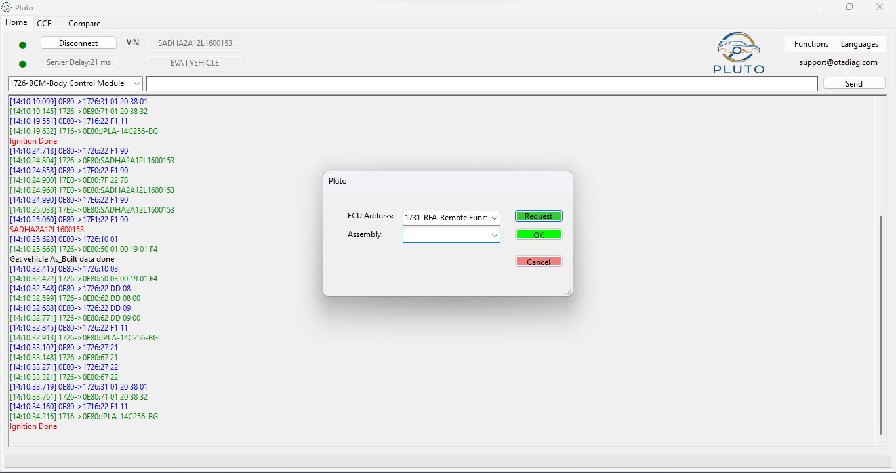
Notes:
ECU for KVM is 1731 – Type in and hit request
Ensure the LATEST update is selected, PLUTO will always select the latest , please double check
Once checked select OK

Slide 27
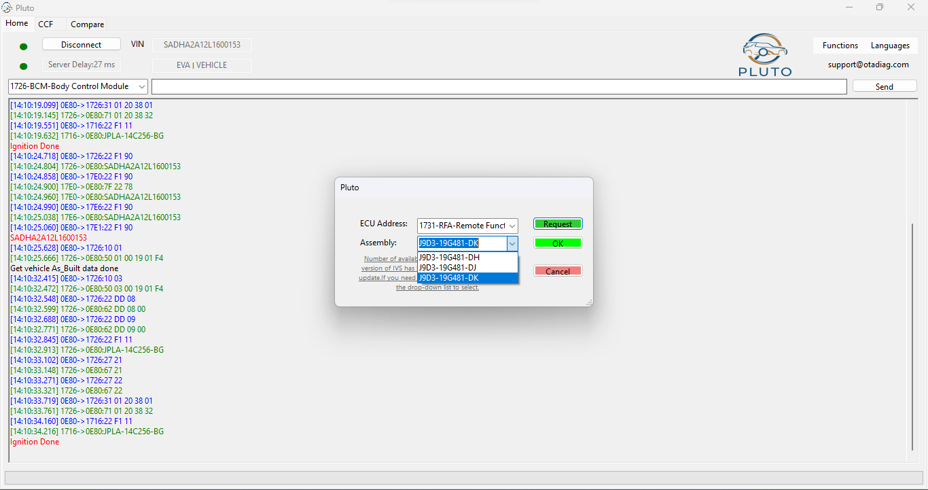
Notes:
ECU for KVM is 1731 – Type in and hit request
Ensure the LATEST update is selected, PLUTO will always select the latest , please double check
Once checked select OK

Slide 28
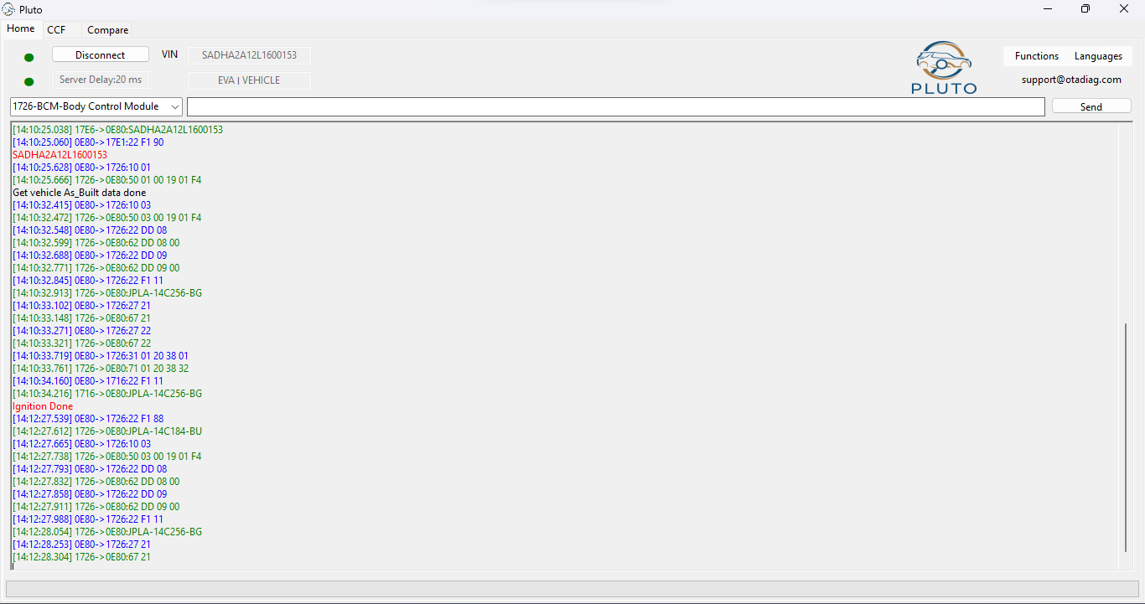
Notes:
Notice at this point the commands ate going to 1726 – this is the BCM – this is normal

Slide 29
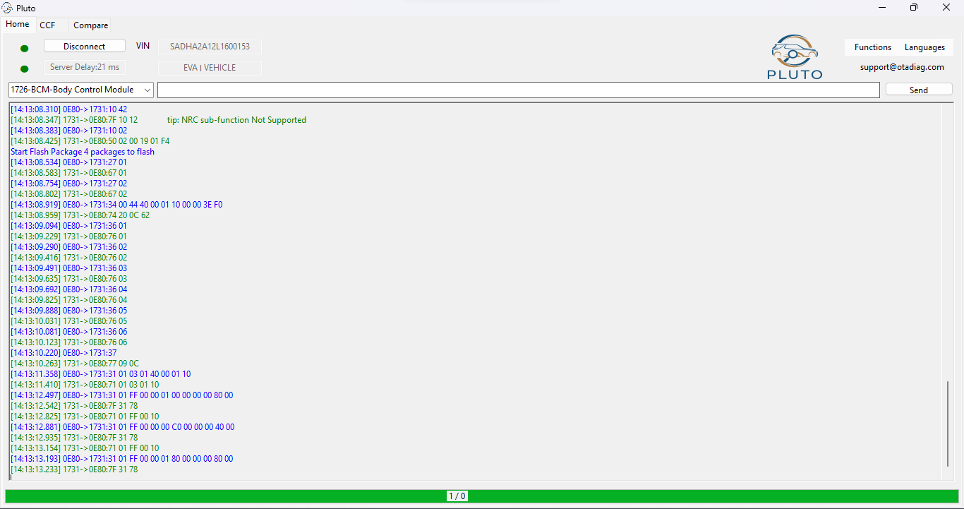
Notes:
Now sending commands and communication with 1731 KVM

Slide 30
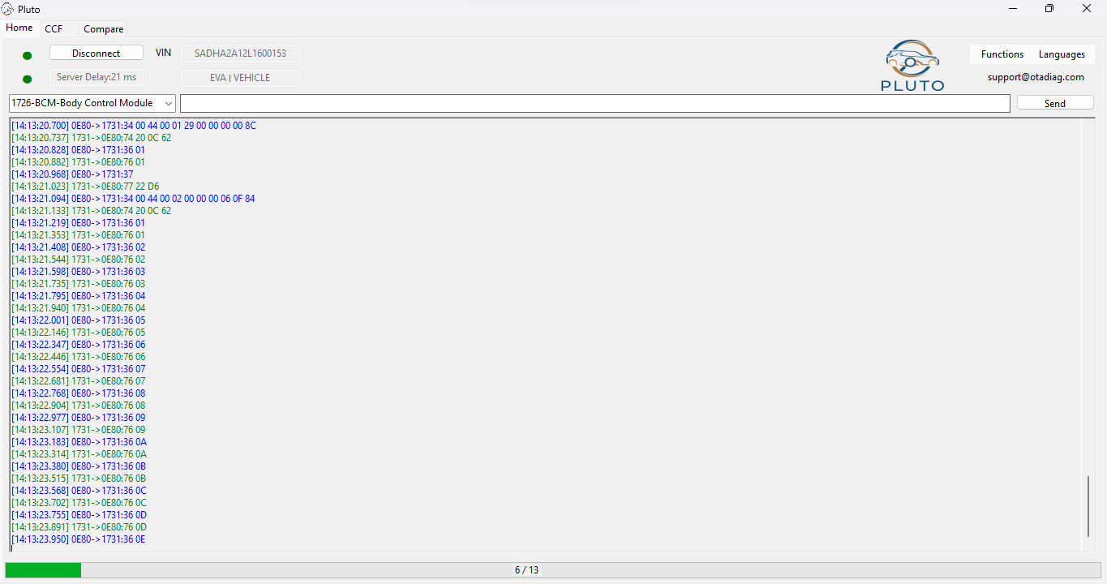
Notes:
This will continue for a short period of time.

Slide 31
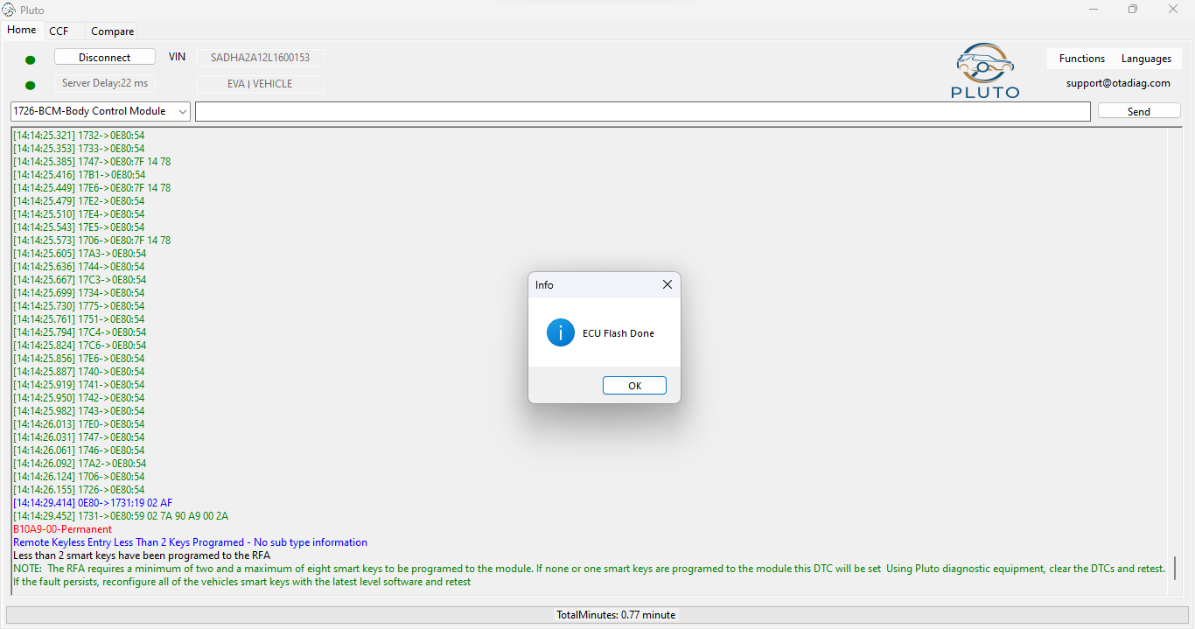
Notes:
Once complete ECU flash complete – (KVM)
Note in blue – remote keyless entry – Less than 2 keys programmed
We must add 2 keys, in this case it will be the original, plus 1 other

Slide 32
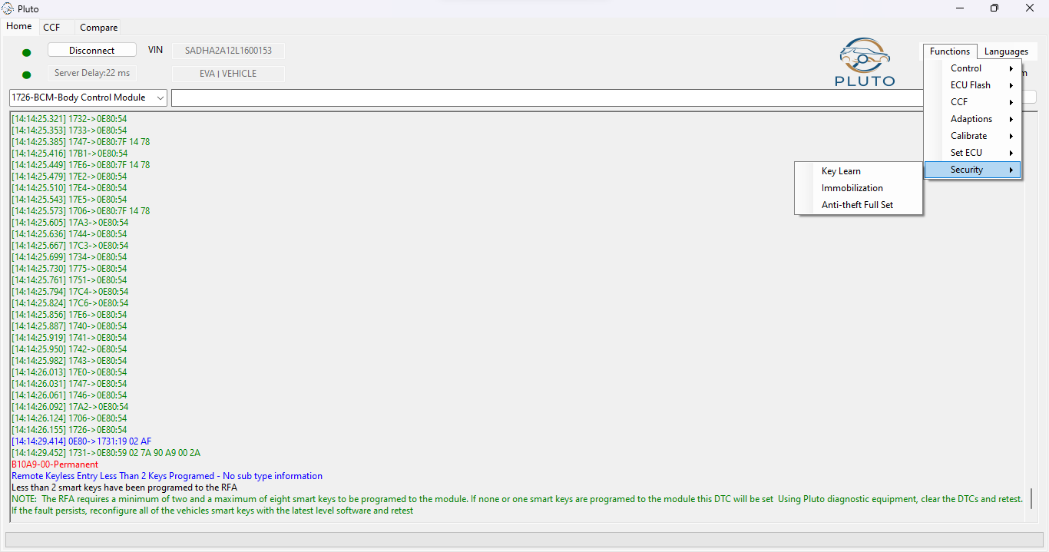
Notes:
From here we are now ready to add keys
Select Functions
Select security
Select learn keys

Slide 33
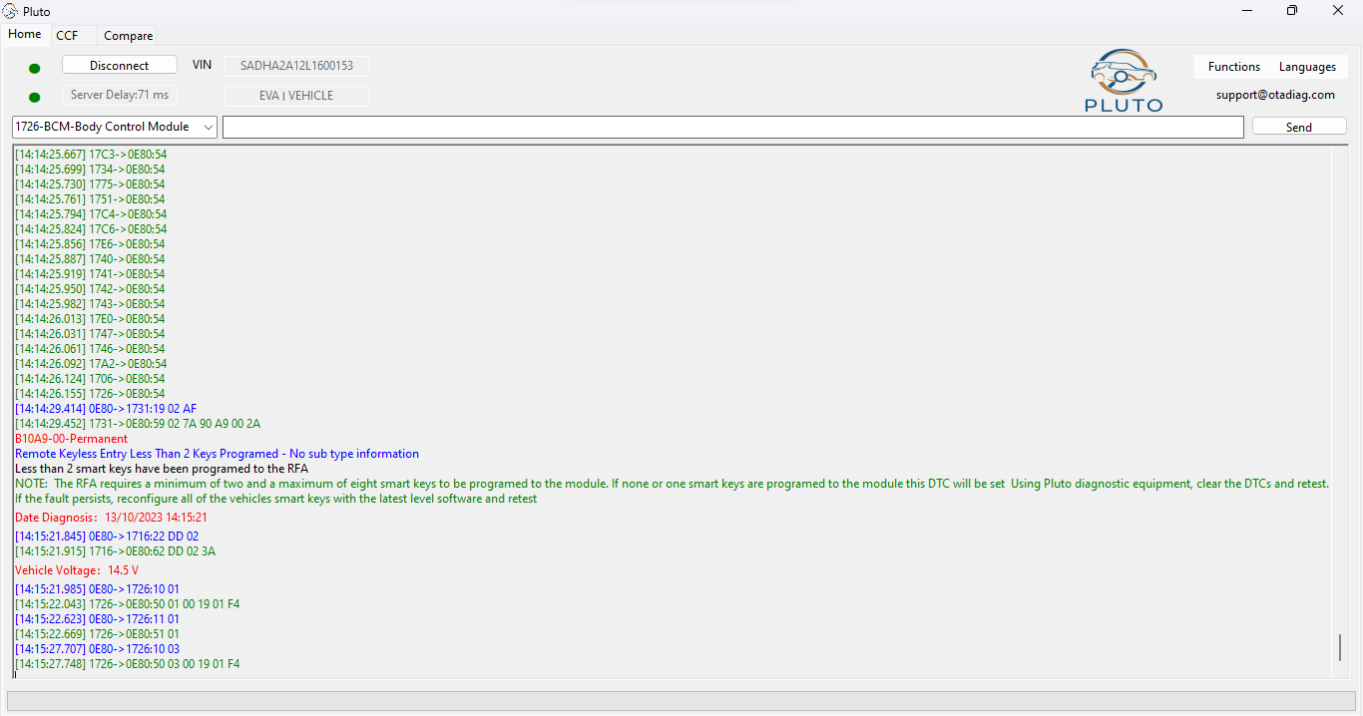
Notes:
Once selected key learning commands will be sent

Slide 34
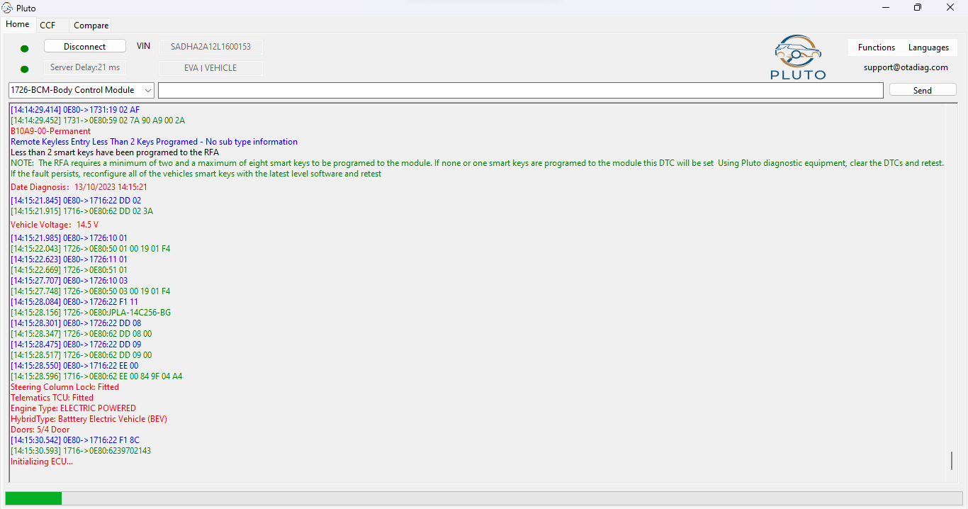
Notes:
In red you will see descriptions, and initialisation of ECU – This is normal

Slide 35
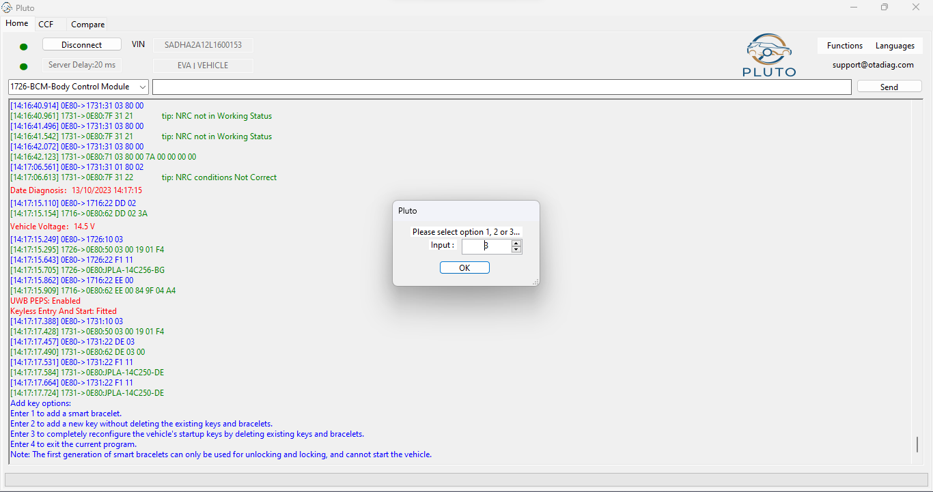
Notes:
In red a command - UWB PEPS enabled – MUST HAVE PEPS key
Select input 3 – Completely reconfigure the vehicles start up by deleting existing keys
If KVM was unlocked – Option 2 will allow add key
Hit ok

Slide 36
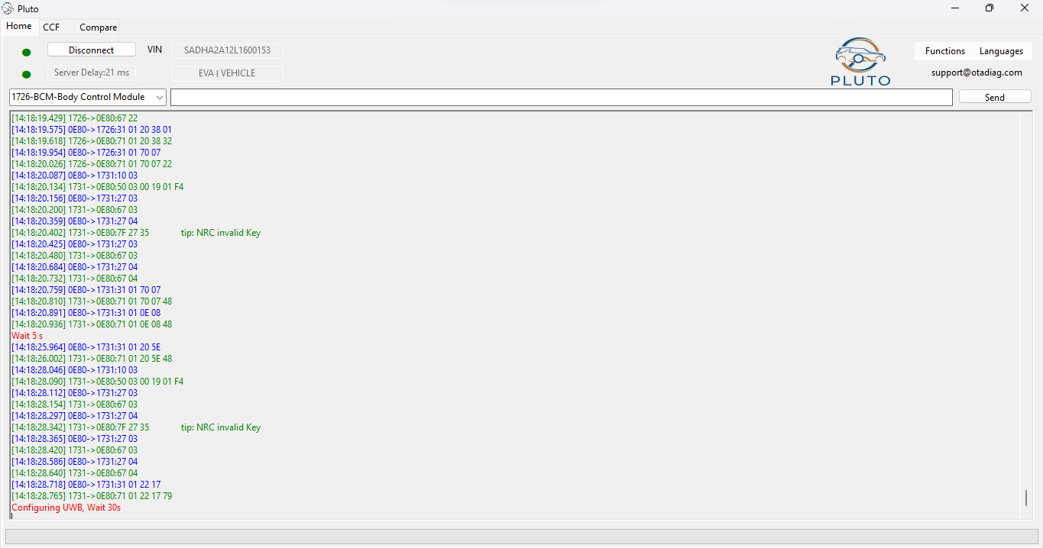
Notes:
Configuration of ULTRA WIDE BAND unit
This is normal

Slide 37
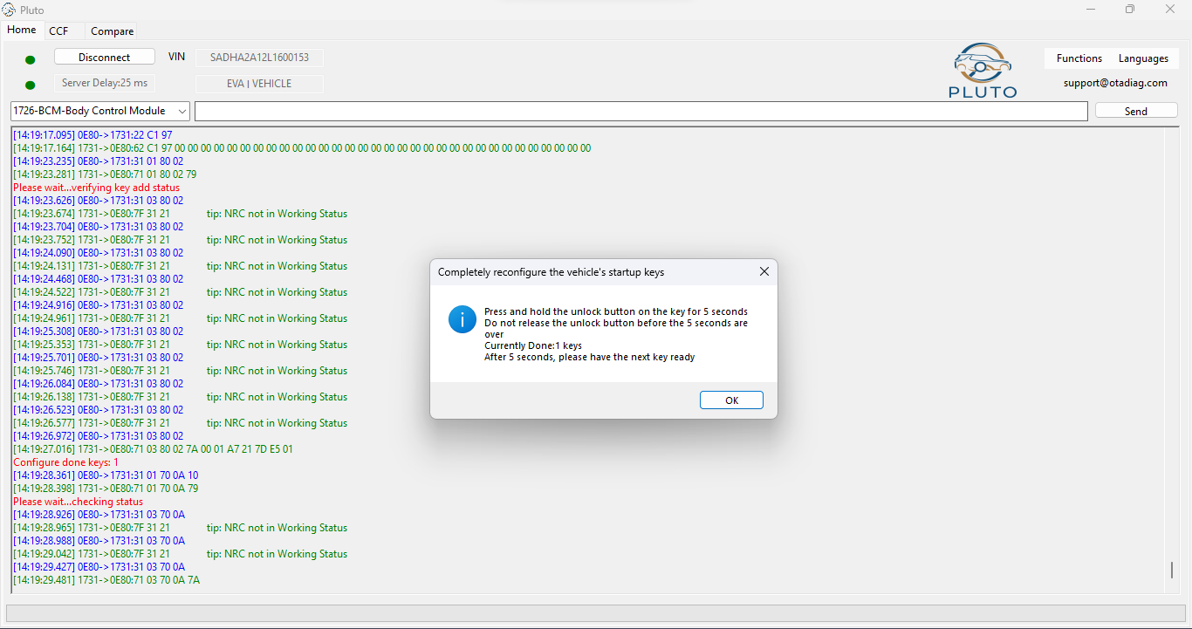
Notes:
Adding keys from this point
Follow the steps in order
When pressing the unlock button, you'll get positive feedback from horn that key is accepted

Slide 38
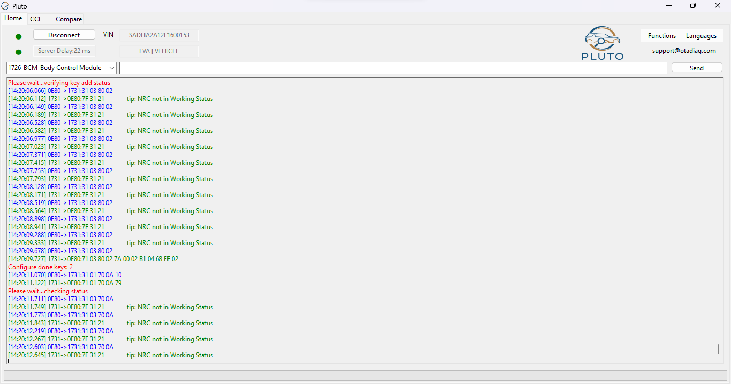
Notes:
In red – Configuration done keys : 2
Allow to finish

Slide 39
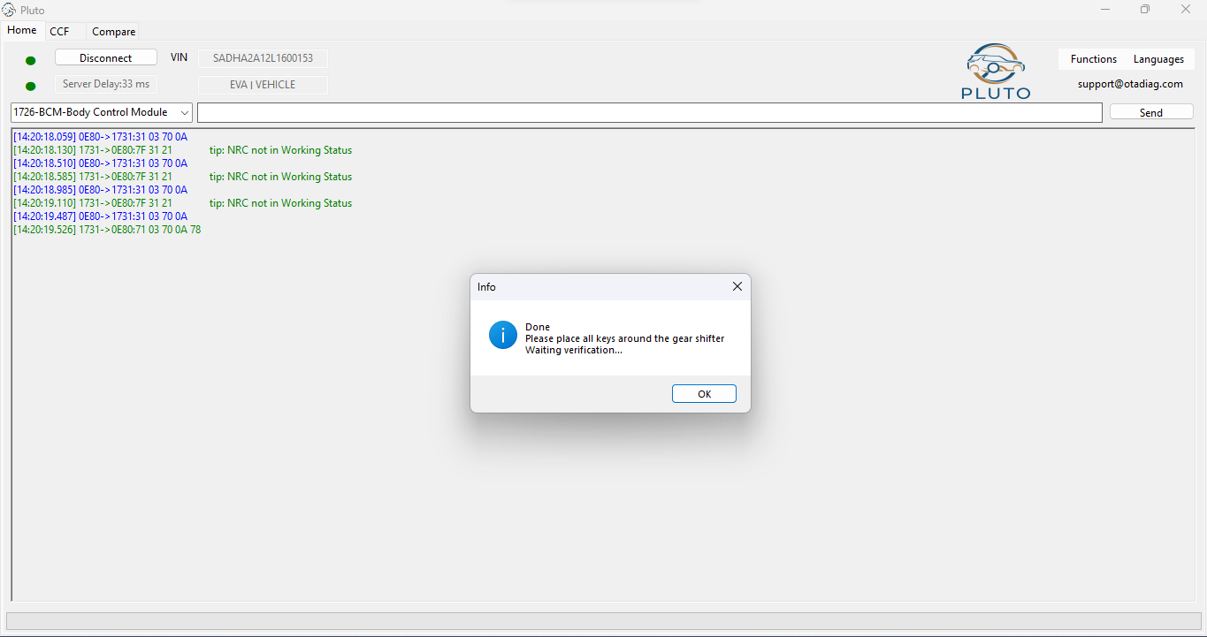
Notes:
Once complete – Place the keys by the gear shifter and wait verification

Slide 40
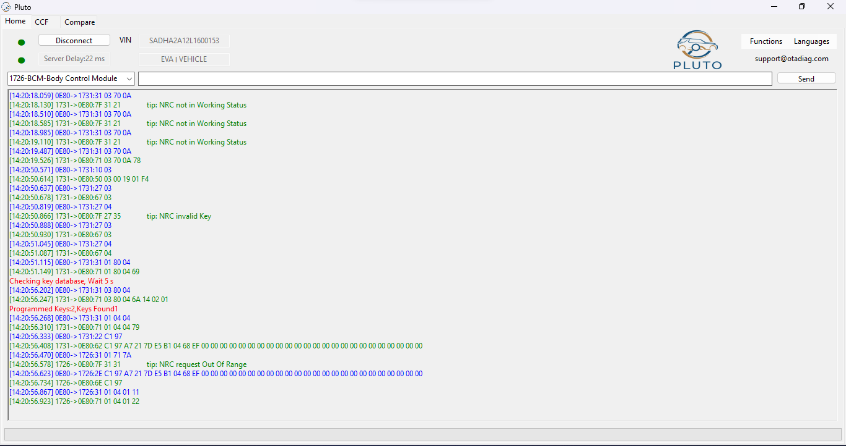
Notes:
The keys will be scanned, In this instant a sleeping battery was in 1 key so wasn’t picked up until we shook it and placed it back.

Slide 41
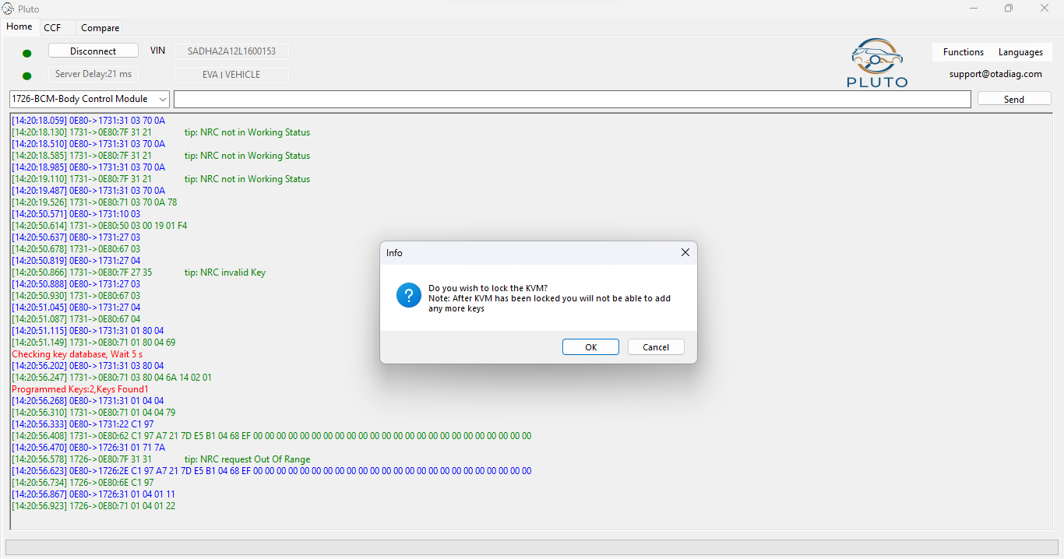
Notes:
You now have the choice to LOCK or leave the KVM UNLOCKED
OK to lock
Cancel to leave unlocked

Slide 42
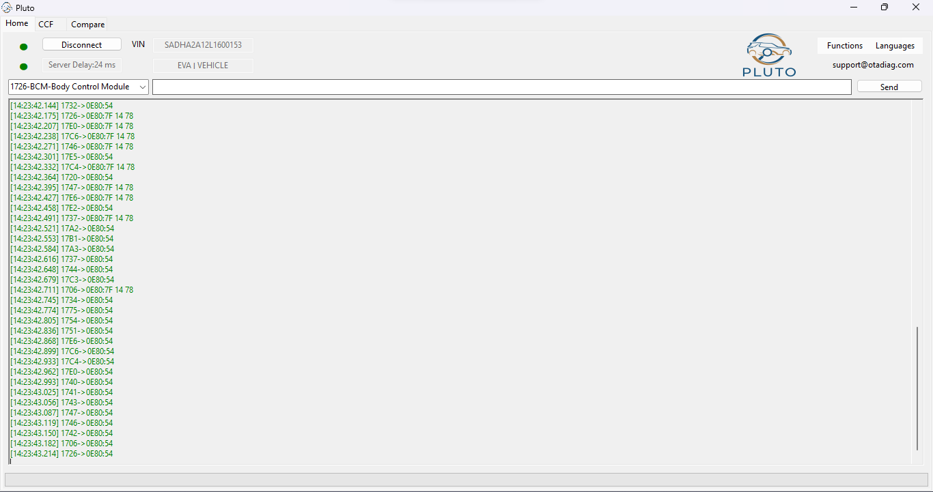
Notes:
You now have the choice to LOCK or leave the KVM UNLOCKED
OK to lock
Cancel to leave unlocked

Slide 43
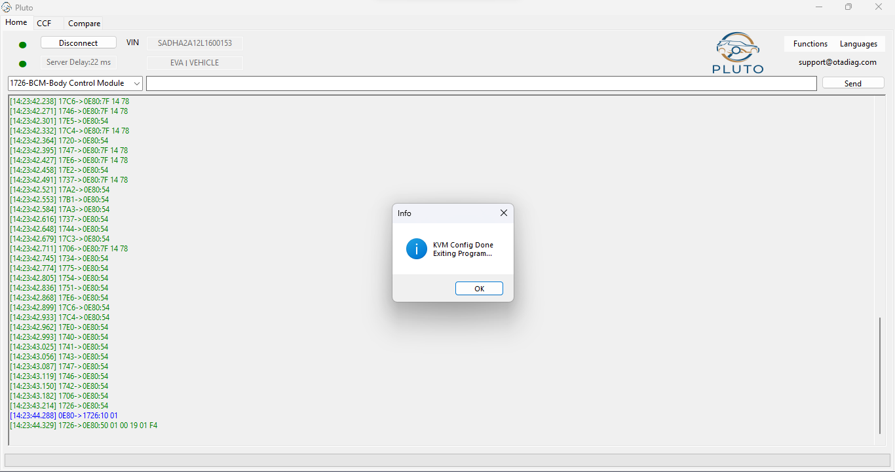
Notes:
KVM configuration complete –
Hit OK

Slide 44
ISSUES from here?
Notes:
If you have issues from here the 2 next options will fix the issue
Immobilisation – will sync the vehicles systems - and can fix the issue
Get as built - will get the get as built from the server and reload to the vehicle – we had to do this on this vehicle –
Wait time – there are also occasions when a 15 min wait will be required – Close all doors and wait 15 mins and test remotes

Slide 45
Any Questions
+90 552 436 80 30
+90 552 756 72 33
Notes:
KVM configuration complete –
Hit OK

Slide 46
PLUTO JLR
PLUTO JLR Full Package For Land Rover and Jaguar 2017-2024

Slide 47
Oto Anahtar ithalat ve toptan ticaret
WWW.AANAHTAR.COM.TR

